Slide 1
ELECTVIZ ELECTION DATA VISUALIZATION FOR ON MEDIA
Infosys Springboard – Virtual Internship 6.0
Mentor: Nithyasri S J
Presented by: Dishant Gangwar

Slide 2

Project Objective
Design an interactive data visualization platform that simplifies analysis of Lok Sabha election results using Power BI.
Enable real-time insights for media teams, researchers, and policymakers by visualizing key trends.
Visualize voter turnout, party performance, and state-wise comparisons across multiple election cycles.
Improve transparency, data-driven storytelling, and public awareness in the democratic process.

Slide 3
The Challenge: Why ElectViz?
Fragmented Data
Inconsistent Data
Election results are spread across separate yearly files (2009-2024). This makes cross-election trend analysis difficult, time-consuming, and prone to error.
We faced varying data formats, renamed states, and inconsistent party acronyms. This required massive manual cleaning and standardization to create a single, reliable source of truth.

Slide 4



Technology Stack
Power BI
Power Query (ETL)
DAX Functions
Used for dashboard development, data modeling, and creating all interactive visualizations.
The engine for data preprocessing. Used to clean, transform, and merge all data sources.
Used to write calculated measures (e.g., Total Votes, Vote Share %, Margin %) to power the analytics.

Slide 5
Project Execution Milestones
M2: Data Modeling
M4: Review & Deploy
Built table relationships and defined core DAX measures for analysis.
Incorporated mentor feedback and optimized for performance.
M1: Data Cleaning
M3: Dashboard Design
Designed visuals for national, state, and party-level insights.
Acquired and refined the dataset, removing all inconsistencies.

Slide 6
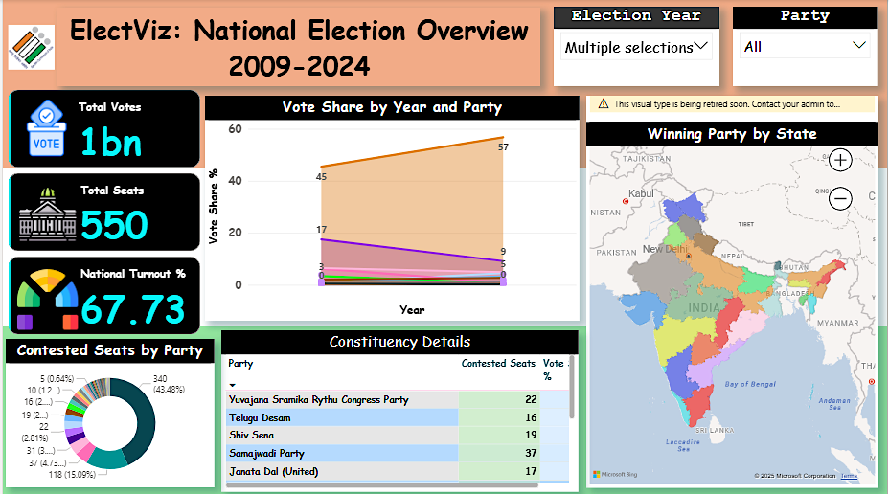
Dashboard Demo: Overview
Focus: Macro-level performance and turnout trends.
Highlights:
- KPI Cards – Total Seats, Total Votes, Turnout %
- Map – Seats by State
- Trend Line – Turnout over time
- Donut Chart – Contested Seat by Party
Interaction: Filter by year to update all visuals instantly.

Slide 7
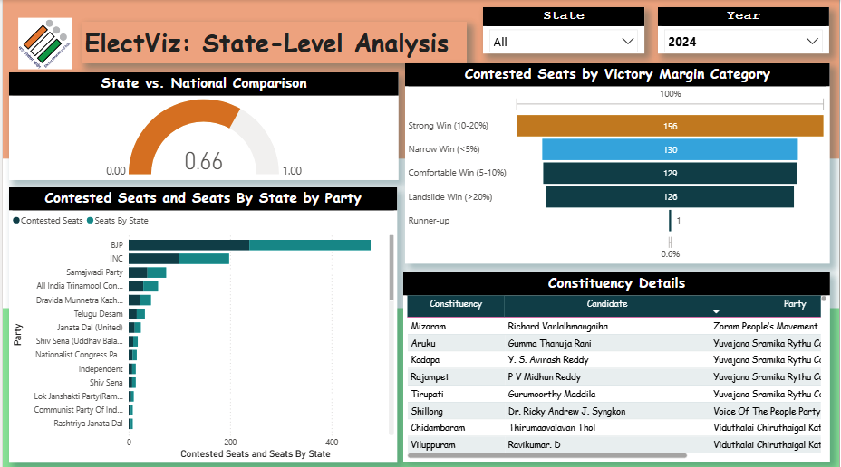
Dashboard Demo: State-Analysis
Focus: Regional-level performance and micro analysis.
Highlights:
- KPIs: State turnout, seats won, leading parties
- Bar Chart: Seat share by party within selected state
- Table: Candidate names, margins, and total votes
Example: Uttar Pradesh — Observe BJP vs. SP seat share shifts.

Slide 8
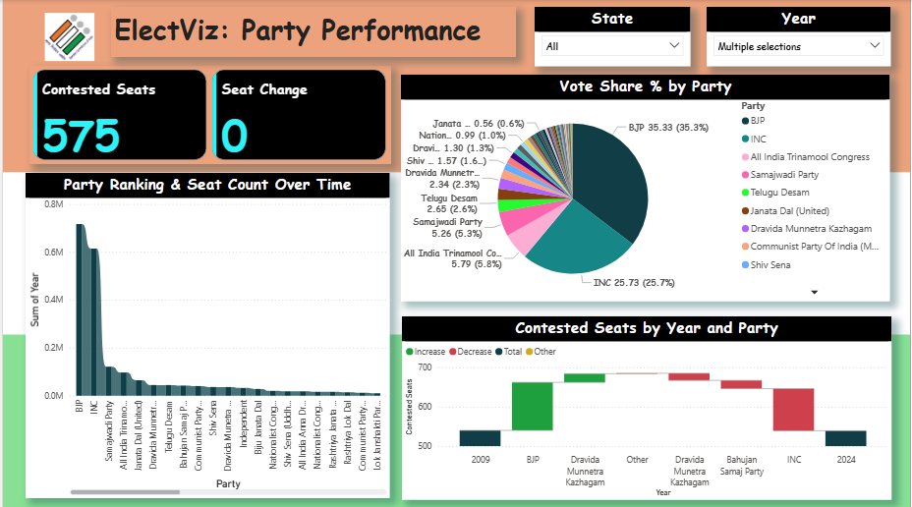
Dashboard Demo: Party Performance
Focus: Temporal and geographic analysis per party.
Highlights:
- Column Chart: Seats won (2009–2024)
- Line Chart: Vote Share % trend
- Map: Regional distribution of wins
Example: Compare BJP and INC performance trajectories.

Slide 9
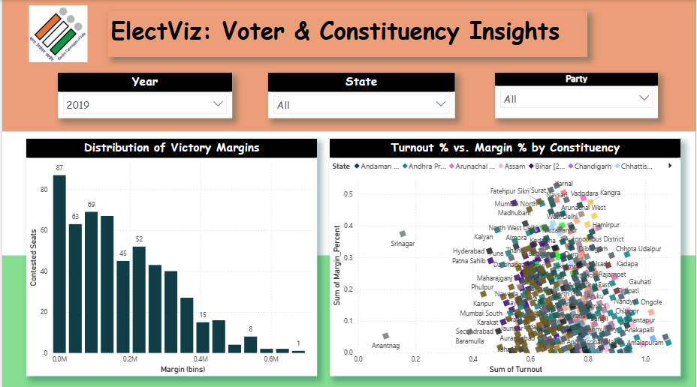
Dashboard Demo: Analytical Insights
Focus: Advanced analytics page (Margins, Turnout, Patterns).
Highlights:
- Histogram: Victory margin distribution
- Scatter Plot: Turnout vs Margin correlation
Insight: Identify competitive constituencies and turnout behavior.

Slide 10
Key Insights Discovered
What the Data Showed
The dashboard revealed clear regional variations in voter turnout and party dominance. We found that major national parties showed concentrated influence in specific zones.
A key insight was that states with higher turnout often correlated with narrower winning margins, indicating stronger political competition.
8.2%
Increase in Turnout

Slide 11
Why ElectViz Matters
Efficiency: Reduces analysis time from days to minutes.
Accuracy: Ensures clean, standardized datasets.
Accessibility: Empowers journalists, analysts, and citizens.
Analytical Depth: Reveals trends across 15 years.
Data Democratization: Makes complex data transparent and explorable.

Slide 12
Future Enhancements
Pre-2009 Integration: Add legacy election data with delimitation mapping.
Socio-Economic Layer: Combine with Census or literacy data.
Real-Time Mode: Live data feed for upcoming elections.
Vision: Transform ElectViz into a comprehensive, real-time election intelligence system.

Slide 13
Conclusion
The ElectViz project successfully transformed raw election datasets into interactive and meaningful insights.
The experience enhanced both technical expertise and analytical thinking, aligning closely with career aspirations in data analytics and research.
The internship provided a valuable opportunity to apply classroom knowledge to real-world data storytelling challenges.
This experience reinforced the value of structured data analytics in creating informed, data-driven narratives.

Slide 14
Acknowledgements
We would like to express our heartfelt gratitude to the Infosys Springboard Team, our mentor Nithyasri S J, and our teammates for their collaboration and support.

Slide 15
THANK YOU

